Slide 1


Data Structures
ETCCDS202
Dr. Aarti
Faculty
School of Engineering & Technology
K.R. Mangalam University
Unit 2 : Linear Data Structures

Slide 2

Unit-2 Linear Data Structures
SESSION 11 Arrays – 1D & 2D
SESSION 12 Static & Dynamic Arrays
SESSION 13 Linked Lists Types
SESSION 14 Linked List Operations
SESSION 15 Stack ADT & Operations
SESSION 16 Stack Applications
SESSION 17 Queue ADT
SESSION 18 Queue Applications
SESSION 19 BFS using Queue
SESSION 20 Revision (Unit–2)
Notes:
New Courses replaced with New Programmes

Slide 3
Queue ADT
Session 17
Introduction to Queue ADT
Definition of Queue & FIFO Principle
Basic Queue Operations
Array Representation of Queue
Algorithms for Enqueue & Dequeue (Array)
Implementation of Queue Using Array
Drawbacks of Array Implementation
Linked List Representation of Queue
Algorithms for Linked Queue Operations
Key Takeaways
References
Notes:
New Courses replaced with New Programmes

Slide 4
Recapitulation (Stack Applications)
Stack is used for expression evaluation and conversion (infix, prefix, postfix).
It helps in function call management using the call stack.
It supports backtracking (e.g., Tower of Hanoi).
It is used to reverse data and check balanced parentheses.
Notes:
New Courses replaced with New Programmes

Slide 5
Quick Quiz
Postfix expressions are evaluated using a __________.
Tower of Hanoi is solved using __________ and stack.
Stack stores function return addresses in the __________ stack.
Infix to postfix conversion uses a stack to store __________.
Which notation places operator after operands?
Name one real-life application of stack.
Which principle is used by stack?
Notes:
New Courses replaced with New Programmes

Slide 6
Learning Objectives
After this lecture, students will be able to:
Define Queue ADT and explain the FIFO principle
Describe different types of queues
Perform basic operations on Queue
Implement queue using arrays and linked lists
Write algorithms for queue operations
Analyze advantages and limitations of different implementations
Notes:
New Courses replaced with New Programmes

Slide 7

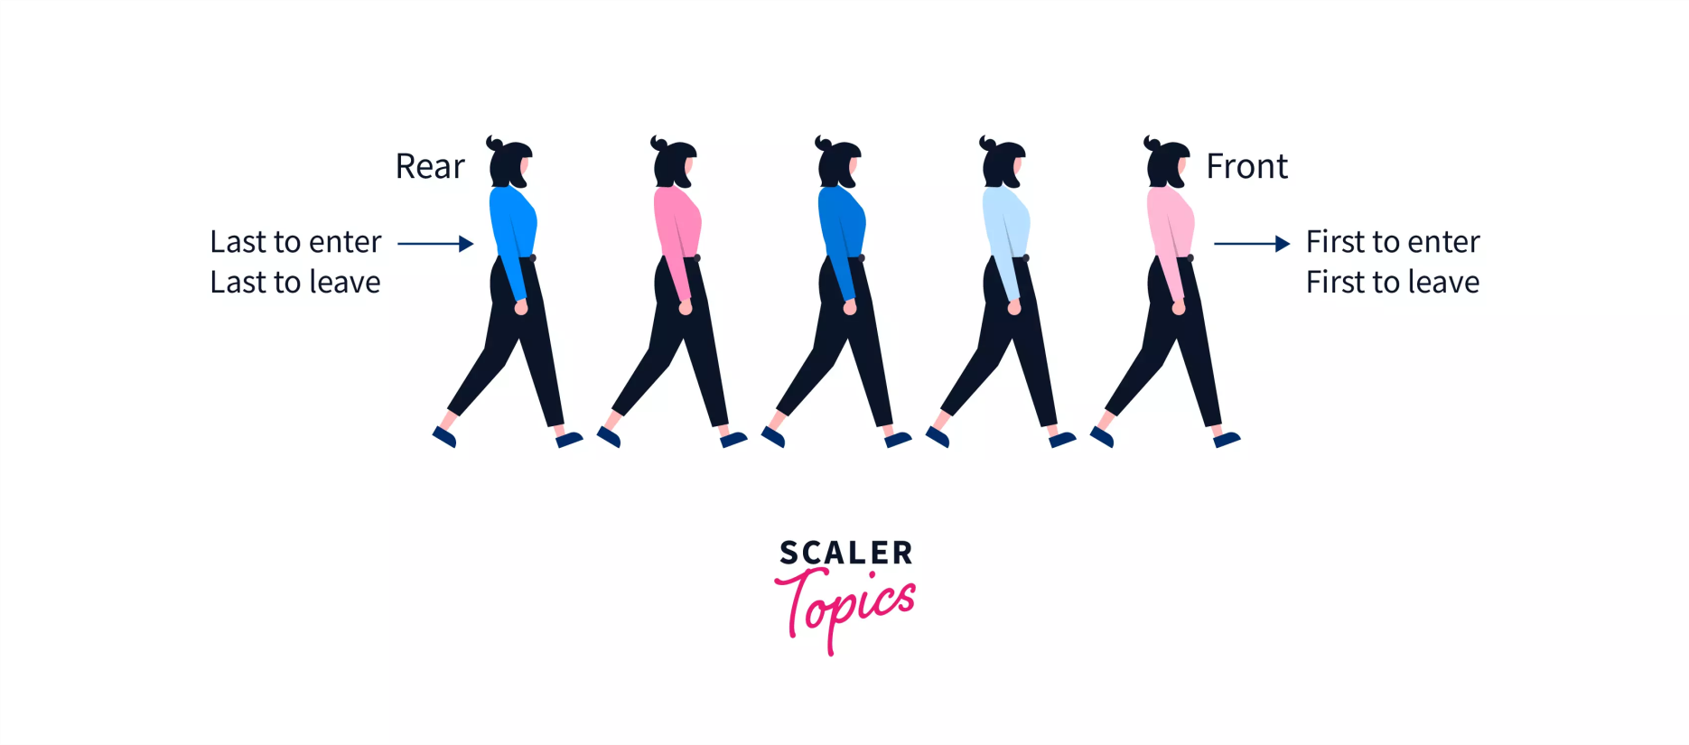
Structure of Queues?
Fig 1 : QUEUE
https://www.scaler.com/topics/data-structures/queue-in-data-structure/
Notes:
New Courses replaced with New Programmes

Slide 8
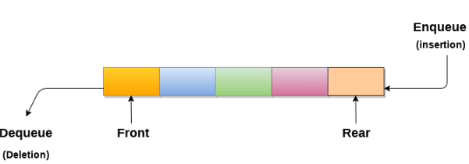
Queues?
An ordered list which enables insert operations to be performed at one end called REAR and delete operations to be performed at another end called FRONT.
Referred to be as First In First Out list.
https://www.javatpoint.com/data-structure-queue
Notes:
New Courses replaced with New Programmes

Slide 9
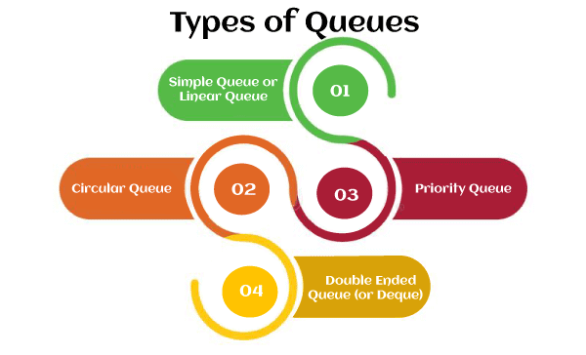
Types
https://www.javatpoint.com/data-structure-queue
Notes:
New Courses replaced with New Programmes

Slide 10
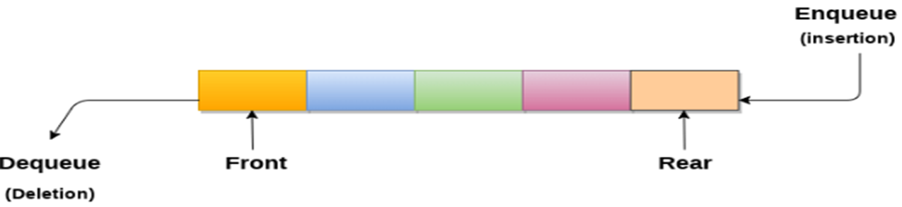
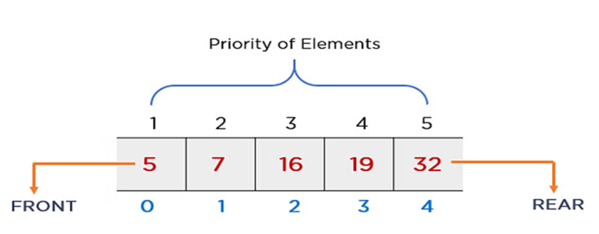
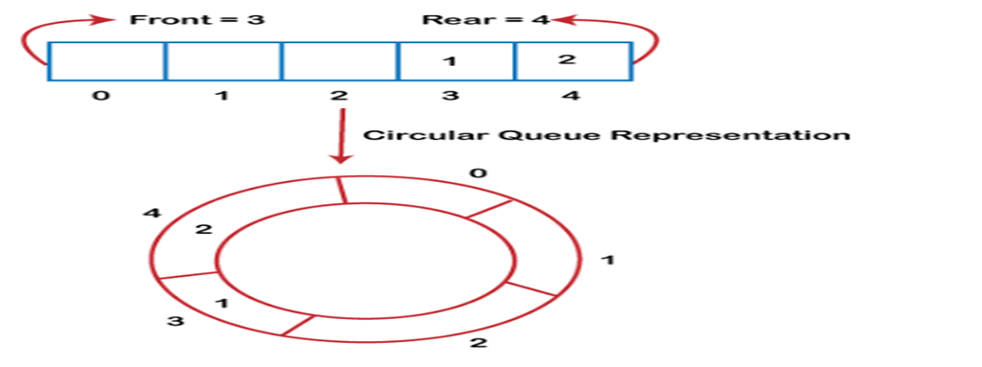
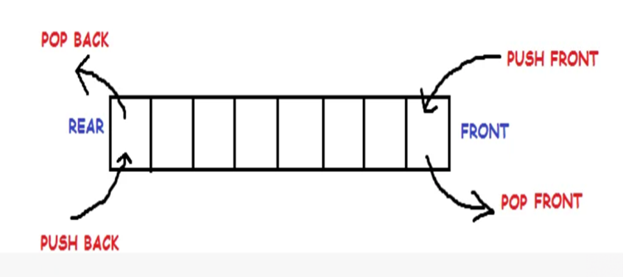
Types
https://www.javatpint.com/data-structure-queue
Notes:
New Courses replaced with New Programmes

Slide 11
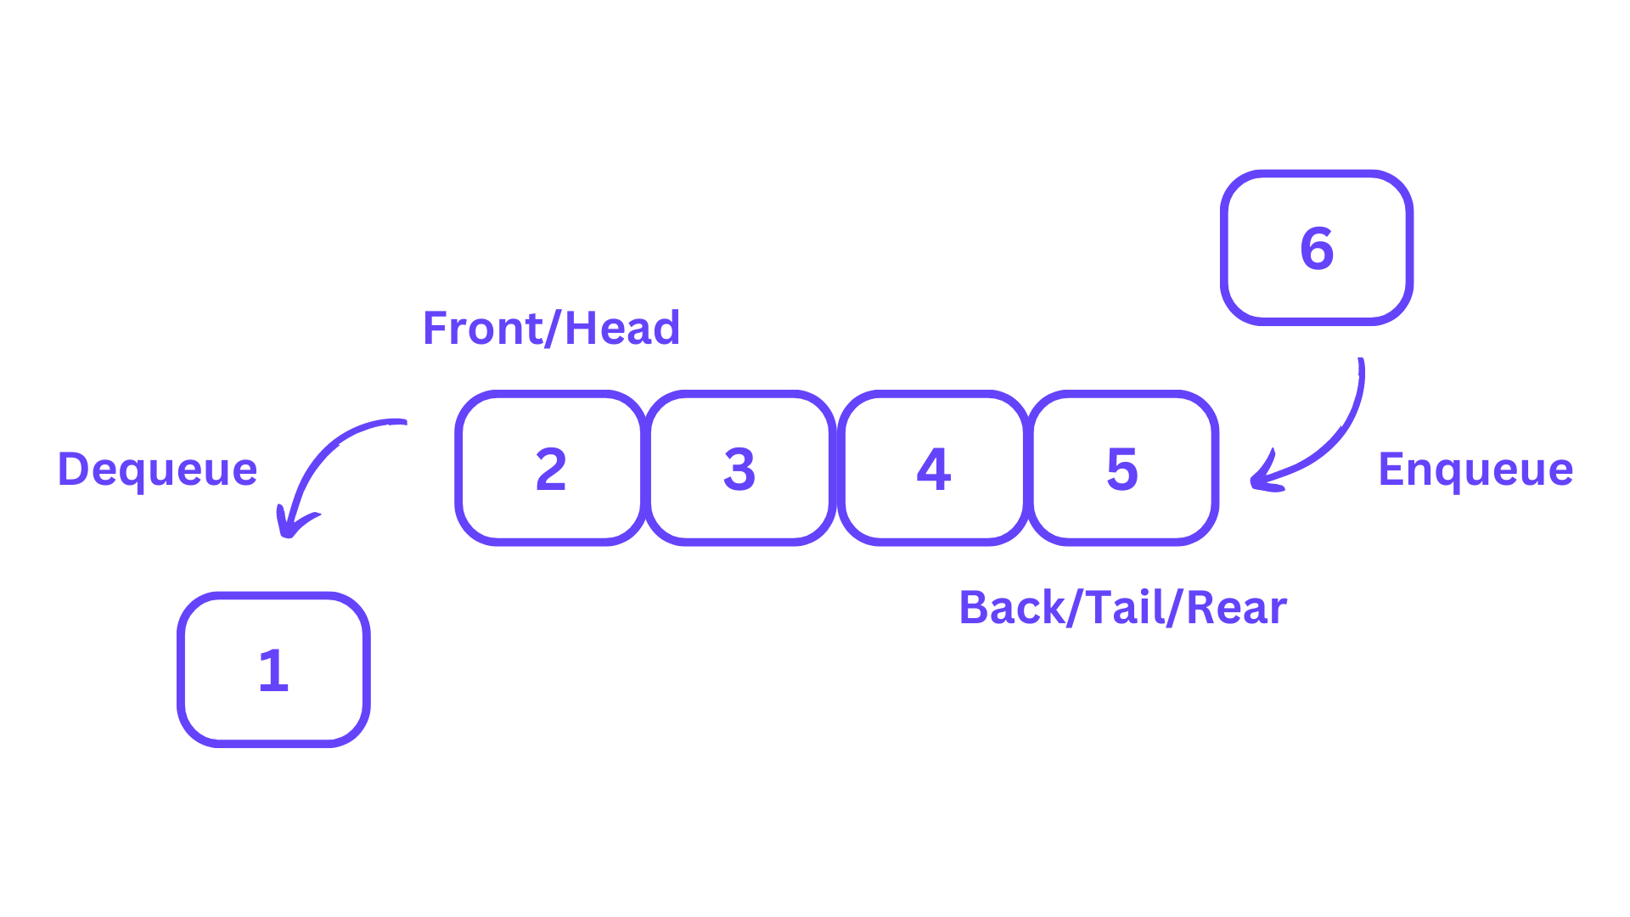
Operations
Enqueue (Insert): Adds an element to the rear of the queue.
Dequeue (Delete): Removes and returns the element from the front of the queue.
Peek: Returns the element at the front of the queue without removing it.
isEmpty: Checks if the queue is empty.
isFull: Checks if the queue is full.
https://learnloner.com/queues-in-data-structures-and-algorithms-dsa/
Notes:
New Courses replaced with New Programmes

Slide 12
Check Your Understanding
Queue follows the __________ principle.
Insertion in a queue is performed at the __________ end.
Deletion in a queue is performed from the __________ end.
The operation used to remove an element is called __________.
What is queue overflow?
Name any one type of queue.
Notes:
New Courses replaced with New Programmes

Slide 13
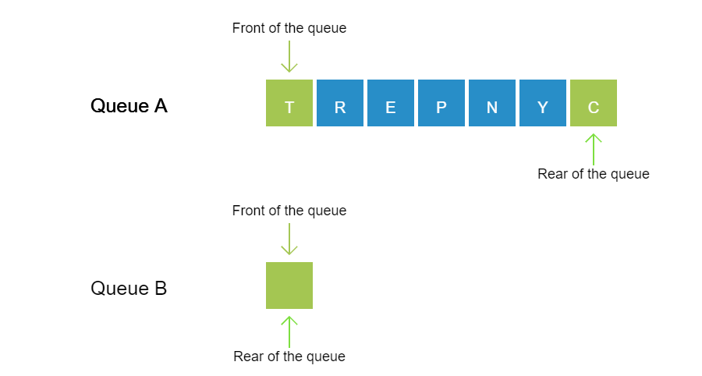
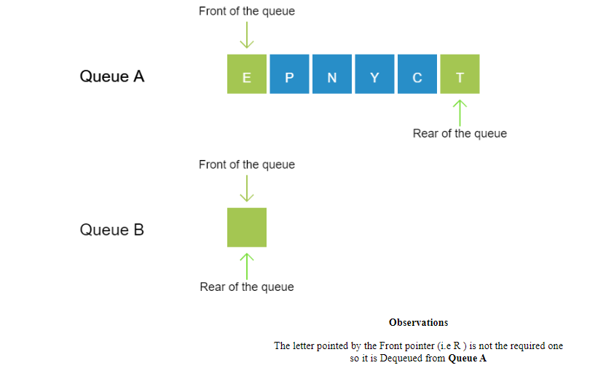
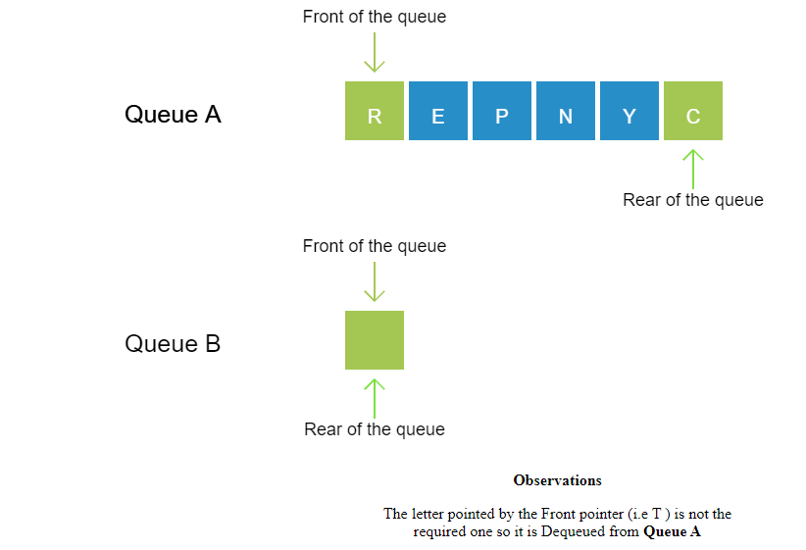
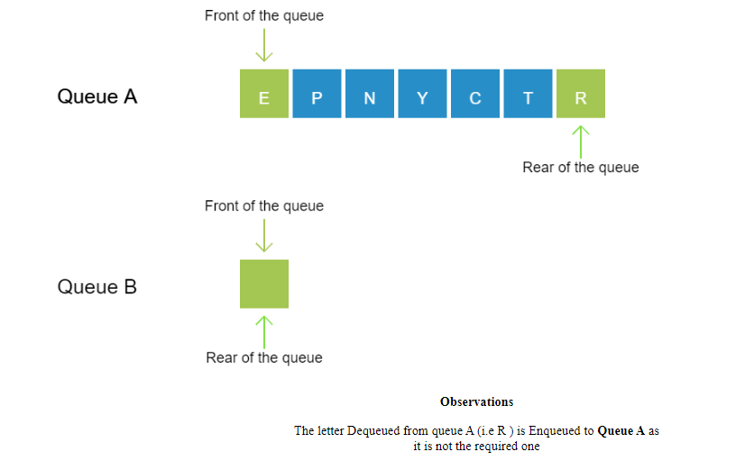
Working of Queue
Observe: The letters in the word "ENCRYPT" are stored in Queue A in a random manner. Observe the operations performed to display the letters in their correct order in Queue B so as to form the actual word.
Notes:
New Courses replaced with New Programmes

Slide 14
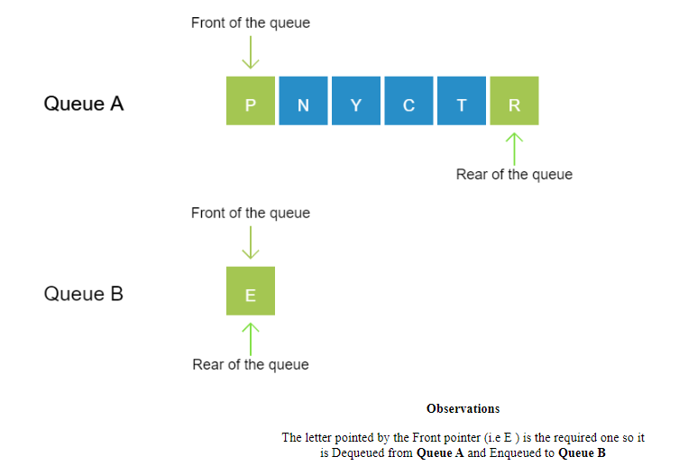
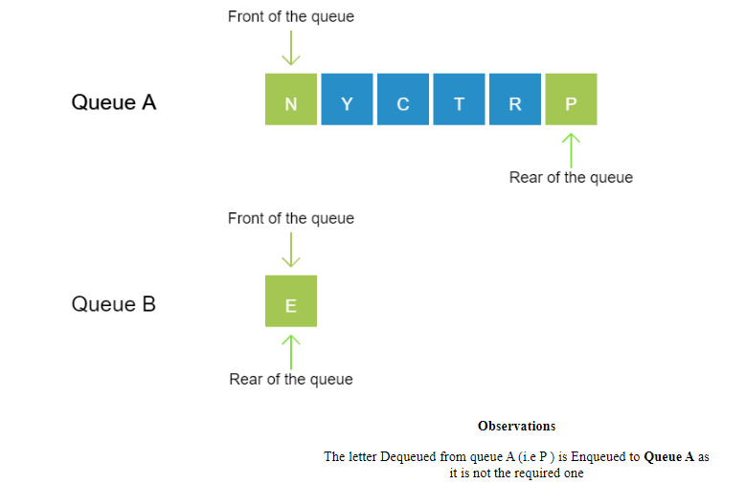
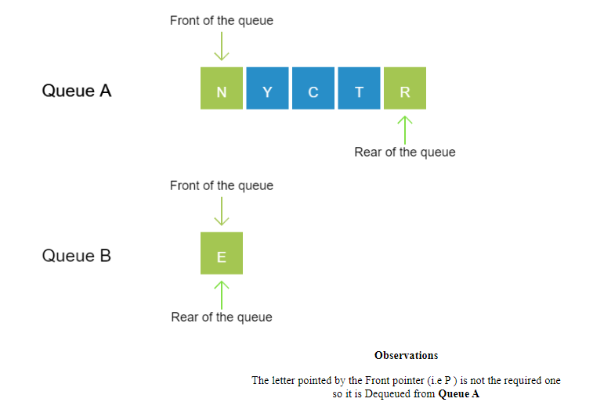
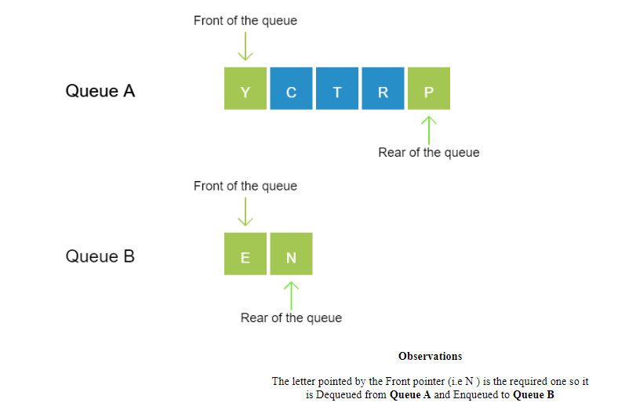
Notes:
New Courses replaced with New Programmes

Slide 15
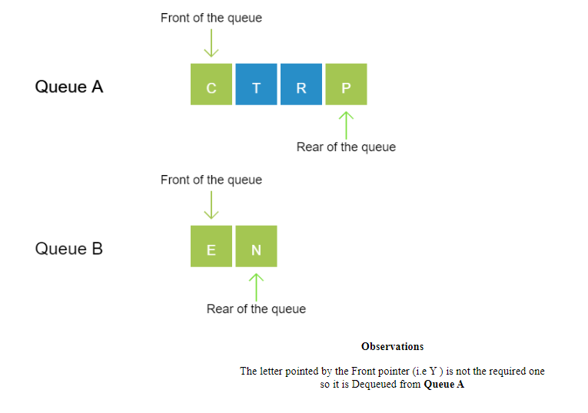
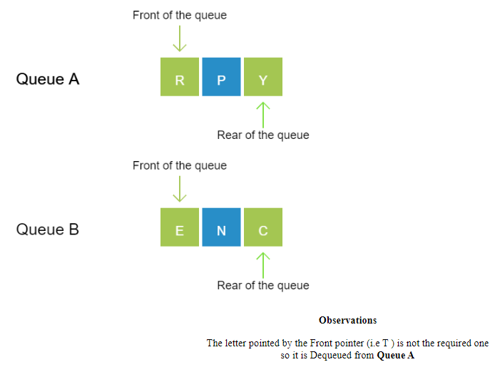
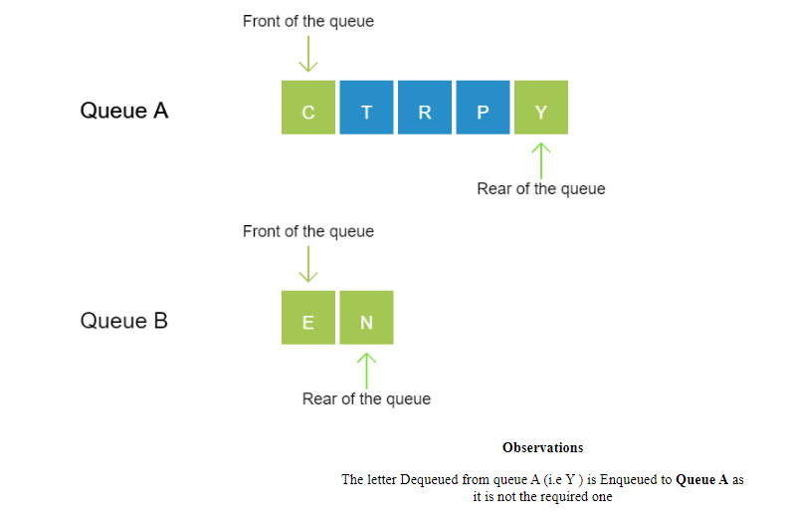
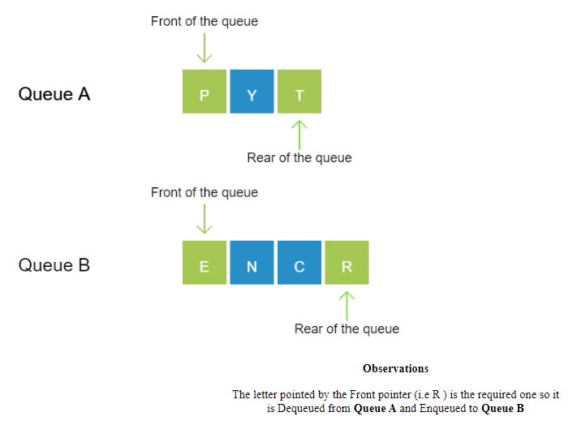
Notes:
New Courses replaced with New Programmes

Slide 16
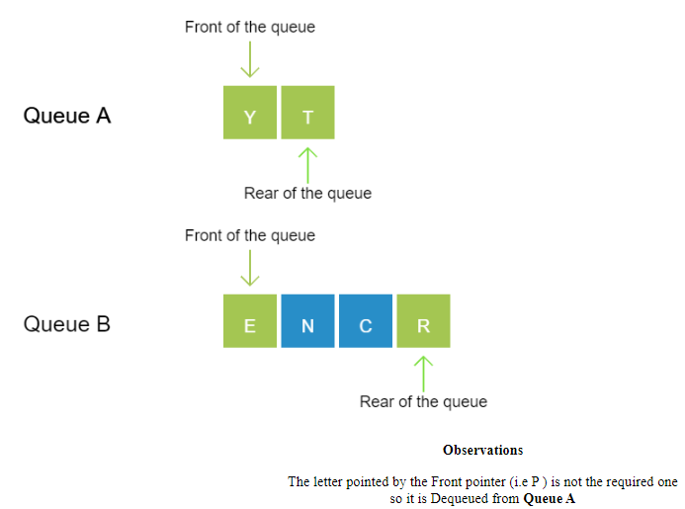
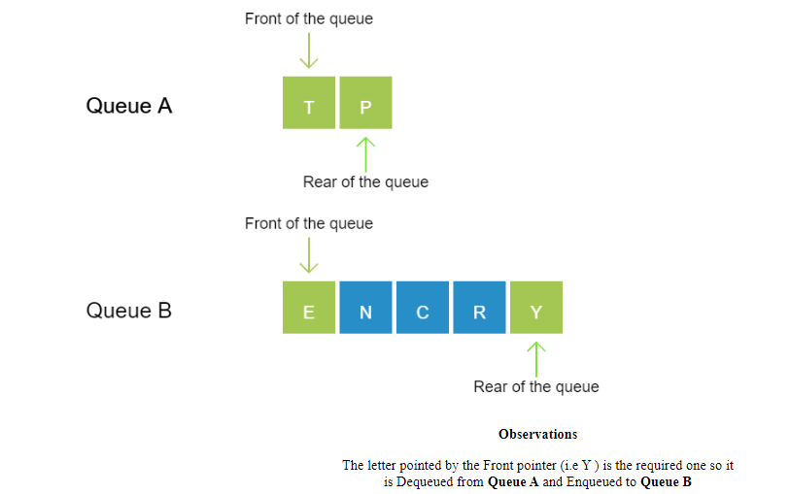
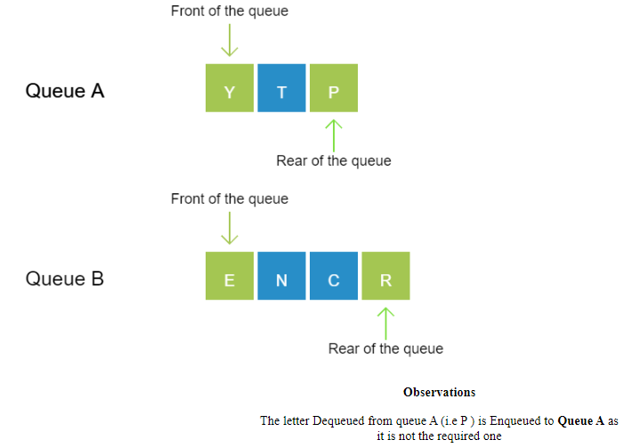
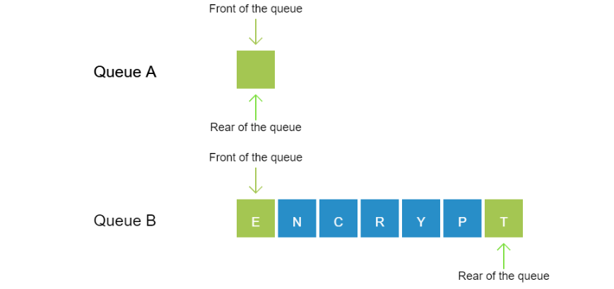
Notes:
New Courses replaced with New Programmes

Slide 17
Test Yourself
Which operation adds an element to the end of a Queue?
Enqueue
Dequeue
Peek
Push
Which operation removes an element from the front of a Queue?
Enqueue
Dequeue
Peek
Push
Notes:
New Courses replaced with New Programmes

Slide 18
Implementation of Linear Queues
Queue can be implemented using:
Arrays
Linked
Notes:
New Courses replaced with New Programmes

Slide 19
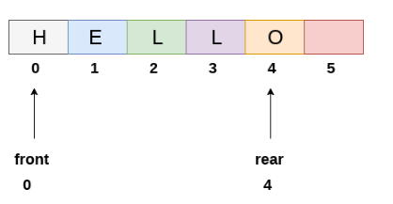
Array based implementation of linear Queues
https://www.javatpoint.com/array-representation-of-queue
Notes:
New Courses replaced with New Programmes

Slide 20
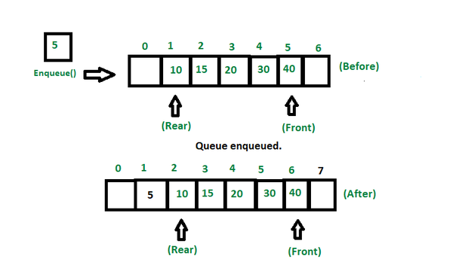
Enqueue Operations
Enqueue (Insert): Algorithm
Step 1: IF REAR = MAX - 1 Write OVERFLOW Go to step [END OF IF]
Step 2: IF FRONT = -1 and REAR = -1 SET FRONT = REAR = 0 ELSE SET REAR = REAR + 1 [END OF IF]
Step 3: Set QUEUE[REAR] = NUM
Step 4: EXIT
https://www.geeksforgeeks.org/basic-operations-for-queue-in-data-structure/
Notes:
New Courses replaced with New Programmes

Slide 21
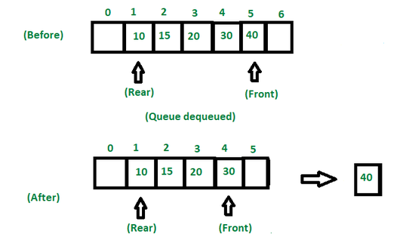
Dequeue Operation
Step 1: IF FRONT = -1 or FRONT > REAR Write UNDERFLOW ELSE SET VAL = QUEUE[FRONT] SET FRONT = FRONT + 1 [END OF IF]
Step 2: EXIT
https://www.geeksforgeeks.org/basic-operations-for-queue-in-data-structure/
Notes:
New Courses replaced with New Programmes

Slide 22
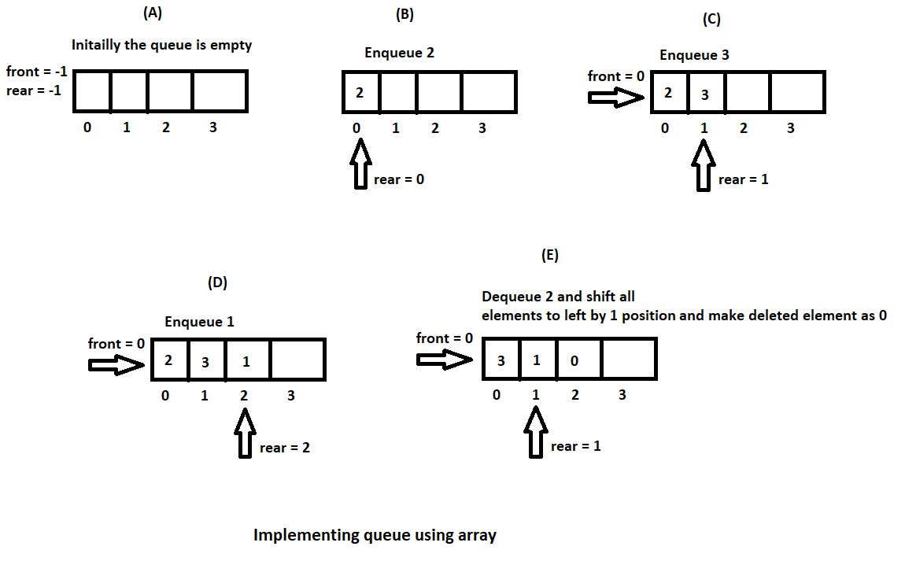
Implementation
https://hetalrachh.home.blog/2020/02/24/implementing-queue-using-array-in-java/
Notes:
New Courses replaced with New Programmes

Slide 23
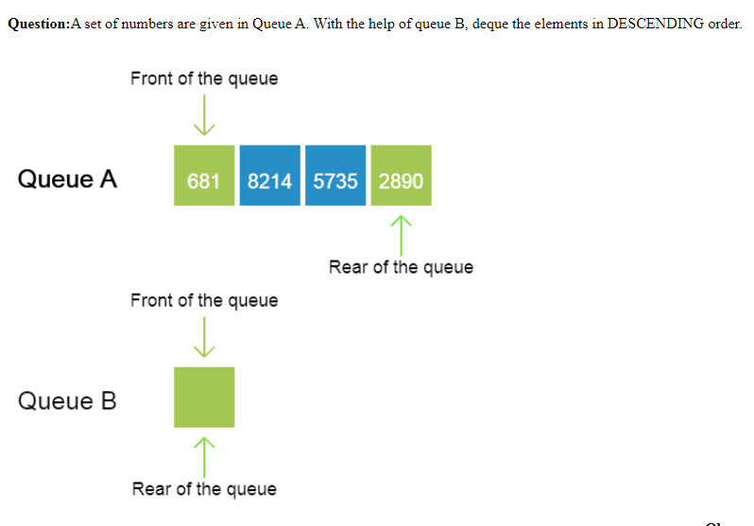
Practice
Question: A set of numbers are given in Queue A. With the help of queue B, deque the elements in DESCENDING order.
Notes:
New Courses replaced with New Programmes

Slide 24
Code for Queue Operations Using Array (Python)
# Queue implementation using array
queue = [0] * 100
n = 100
front = -1
rear = -1
def insert():
global front, rear
if rear == n - 1:
print("Queue Overflow")
else:
if front == -1:
front = 0
val = int(input("Insert the element in queue: "))
rear += 1
queue[rear] = val
def delete():
global front, rear
if front == -1 or front > rear:
print("Queue Underflow")
else:
print("Element deleted from queue is:", queue[front])
front += 1
def display():
if front == -1 or front > rear:
print("Queue is empty")
else:
print("Queue elements are:", end=" ")
for i in range(front, rear + 1):
print(queue[i], end=" ")
print()
Notes:
New Courses replaced with New Programmes

Slide 25
Code for Queue Operations Using Array (Python)
def main():
while True:
print("\n1) Insert element to queue")
print("2) Delete element from queue")
print("3) Display all the elements of queue")
print("4) Exit")
ch = int(input("Enter your choice: "))
if ch == 1:
insert()
elif ch == 2:
delete()
elif ch == 3:
display()
elif ch == 4:
print("Exit")
break
else:
print("Invalid choice")
if __name__ == "__main__":
main()
Notes:
New Courses replaced with New Programmes

Slide 26
Output
Insert element to queue
Delete element from queue
Display all the elements of queue
Exit Enter your choice : 1
Insert the element in queue : 4
Enter your choice : 1
Insert the element in queue : 3
Enter your choice : 1
Insert the element in queue : 5
Enter your choice : 2
Element deleted from queue is : 4
Enter your choice : 3
Queue elements are : 3 5
Enter your choice : 7 Invalid
Notes:
New Courses replaced with New Programmes

Slide 27
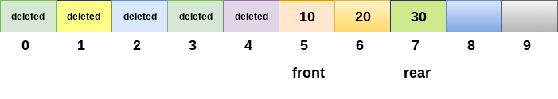
Drawback of array implementation
Memory wastage
Deciding the array size
Notes:
New Courses replaced with New Programmes

Slide 28
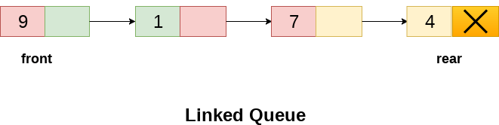
Implementation of Queue using Linked List
In a linked queue, each node of the queue consists of two parts i.e. data part and the link part.
Each element of the queue points to its immediate next element in the memory.
Notes:
New Courses replaced with New Programmes

Slide 29
Operation on Linked Queue
Insert operation
The new element will be the last element of the queue.
Firstly, allocate the memory for the new node ptr
ptr = (struct node *) malloc (sizeof(struct node));
Notes:
New Courses replaced with New Programmes

Slide 30
Operation on Linked Queue
There can be two scenarios of inserting this new node ptr into the linked queue.
Queues is empty
ptr -> data = item;
if(front == NULL)
{
front = ptr;
rear = ptr;
front -> next = NULL;
rear -> next = NULL;
}
Notes:
New Courses replaced with New Programmes

Slide 31
Operation on Linked Queue
2. The queue contains more than one element.
rear -> next = ptr;
rear = ptr;
rear->next = NULL;
Notes:
New Courses replaced with New Programmes

Slide 32
Algorithm for insert Operation on Linked Queue
Step 1: Allocate the space for the new node PTR
Step 2: SET PTR -> DATA = VAL
Step 3: IF FRONT = NULL SET FRONT = REAR = PTR SET FRONT -> NEXT = REAR -> NEXT = NULL ELSE SET REAR -> NEXT = PTR SET REAR = PTR SET REAR -> NEXT = NULL [END OF IF]
Step 4: END
Notes:
New Courses replaced with New Programmes

Slide 33
Delete Operation on Linked Queue
Deletion operation removes the element that is first inserted among all the queue elements.
ptr = front;
front = front -> next;
free(ptr);
Notes:
New Courses replaced with New Programmes

Slide 34
Algorithm for Delete Operation on Linked Queue
Step 1: IF FRONT = NULL Write " Underflow " Go to Step 5 [END OF IF]
Step 2: SET PTR = FRONT
Step 3: SET FRONT = FRONT -> NEXT
Step 4: FREE PTR
Step 5: END
Notes:
New Courses replaced with New Programmes

Slide 35
Key Takeaways
Queue is a linear data structure based on FIFO.
Insertion happens at rear; deletion happens from front.
Main operations: enqueue, dequeue, peek, isEmpty, isFull.
Queue can be implemented using arrays or linked lists.
Array-based queue is simple but may cause memory wastage and fixed size issues.
Linked list implementation allows dynamic size.
Notes:
New Courses replaced with New Programmes

Slide 36
References
Textbooks
Cormen, T. H., Leiserson, C. E., Rivest, R. L., & Stein, C., Introduction to Algorithms, MIT Press.
Lipschutz, S., Schaum’s Outline of Data Structures with C++, McGraw-Hill Education.
Reference Books
Weiss, M. A., Data Structures and Algorithm Analysis in C++, 5th Edition, Pearson Education.
Skiena, S. S., The Algorithm Design Manual, 3rd Edition, Springer.
Online Resources
GeeksforGeeks – Queue in Data Structures https://www.geeksforgeeks.org/queue-data-structure/
Scaler – Queue in Data Structures https://www.scaler.com/topics/data-structures/queue-in-data-structure/
JavaTpoint – Queue Data Structure https://www.javatpoint.com/data-structure-queue
Programiz – Queue in Python https://www.programiz.com/dsa/queue
TutorialsPoint – Queue Operations https://www.tutorialspoint.com/data_structures_algorithms/queue_algorithm.htm
Notes:
New Courses replaced with New Programmes

Slide 37
THANK YOU

